Slide 1

Reduced Order Models (ROMs) RAVEN Workshop

Slide 2
Outline
Brief introduction on ROMs
ROMs and RAVEN
Available ROMs
RAVEN ROM workflow
RAVEN examples
Create ROMs
Perform sampling of ROMs

Slide 3
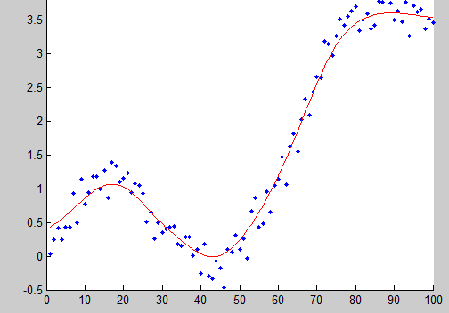
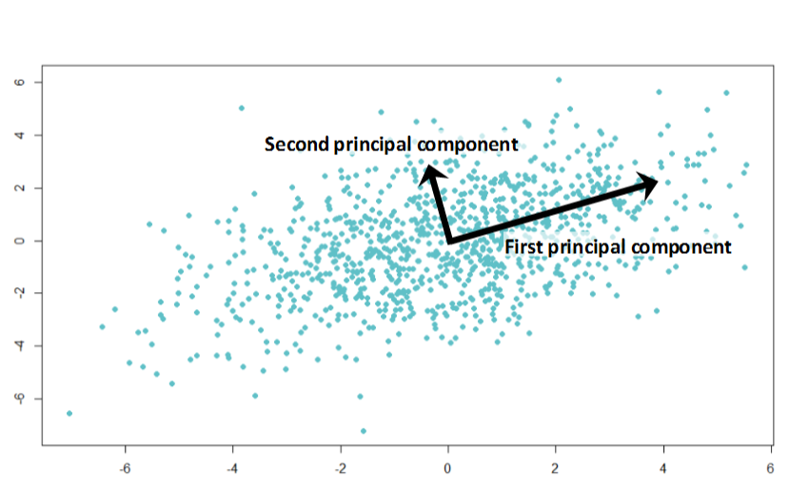
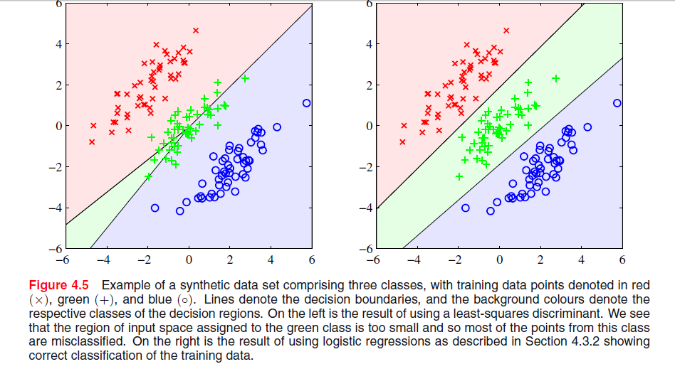
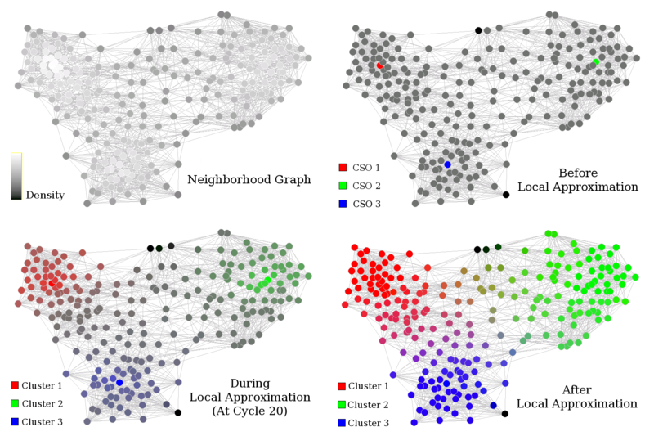
Methods and Taxonomy
LA
Opt
Alg
Stat
'Field of study that gives
computers the ability to learn
without being explicitly
programmed’ – Arthur Samuel 1959
ML
Supervised
Unsupervised
Reinforcement
ROM
Regression
Dimensionality Reduction
Q-learning
Classification
Clustering
SARSA
DeepRL

Slide 4
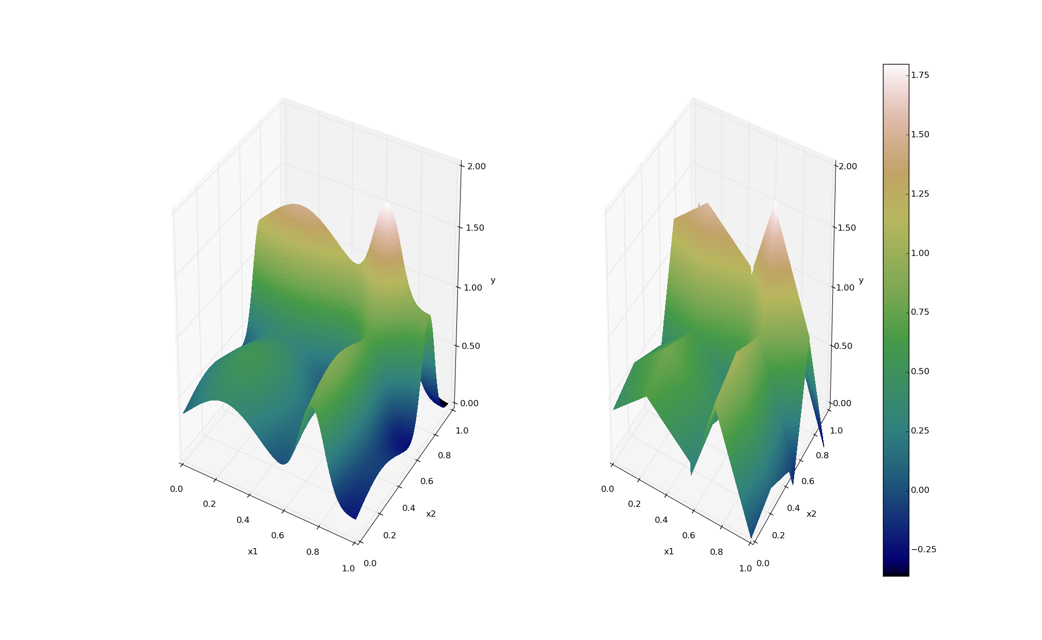
ROMs: a Brief Introduction
Output: Simulation outcome (success/failure, max clad temperature)
Consider a set of N data points
Build a surrogate model
Reduced Order Model
DataObjects
(PointSet)
Inputs: Initial and boundary conditions
≅

Slide 5
ROMs: a Brief Introduction
Basically we are trying to reduce the complexity of the original model
Pros:
Much faster computation of the output variable
Cons:
Presence of error in the ROM computed values
ROM (e.g., quadratic regressor)
≅
Original data (e.g., RELAP5)

Slide 6
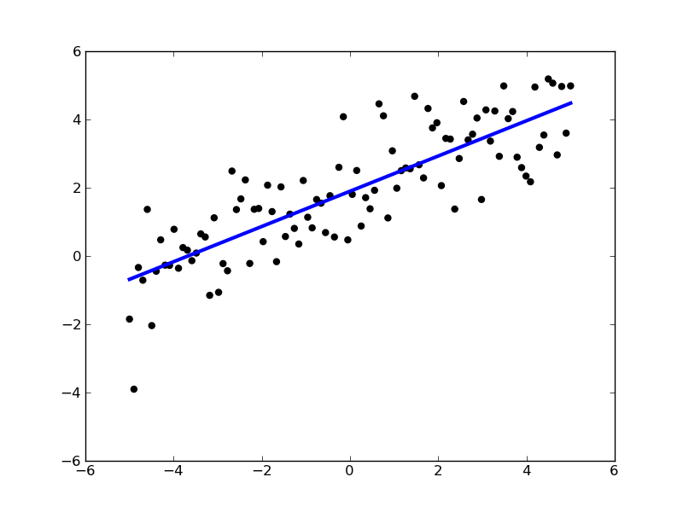
ROMs: Applications
Basic steps:
Sample original model
Train the ROM
Validate the ROM
Perform desired analysis with the ROM
instead of the original model
Range of applications:
Uncertainty quantification / Sensitivity analysis
Probabilistic Risk Analysis (PRA)
Accelerator for stochastic analysis (adaptive sampling)
Prediction models
Output y
Input x

Slide 7
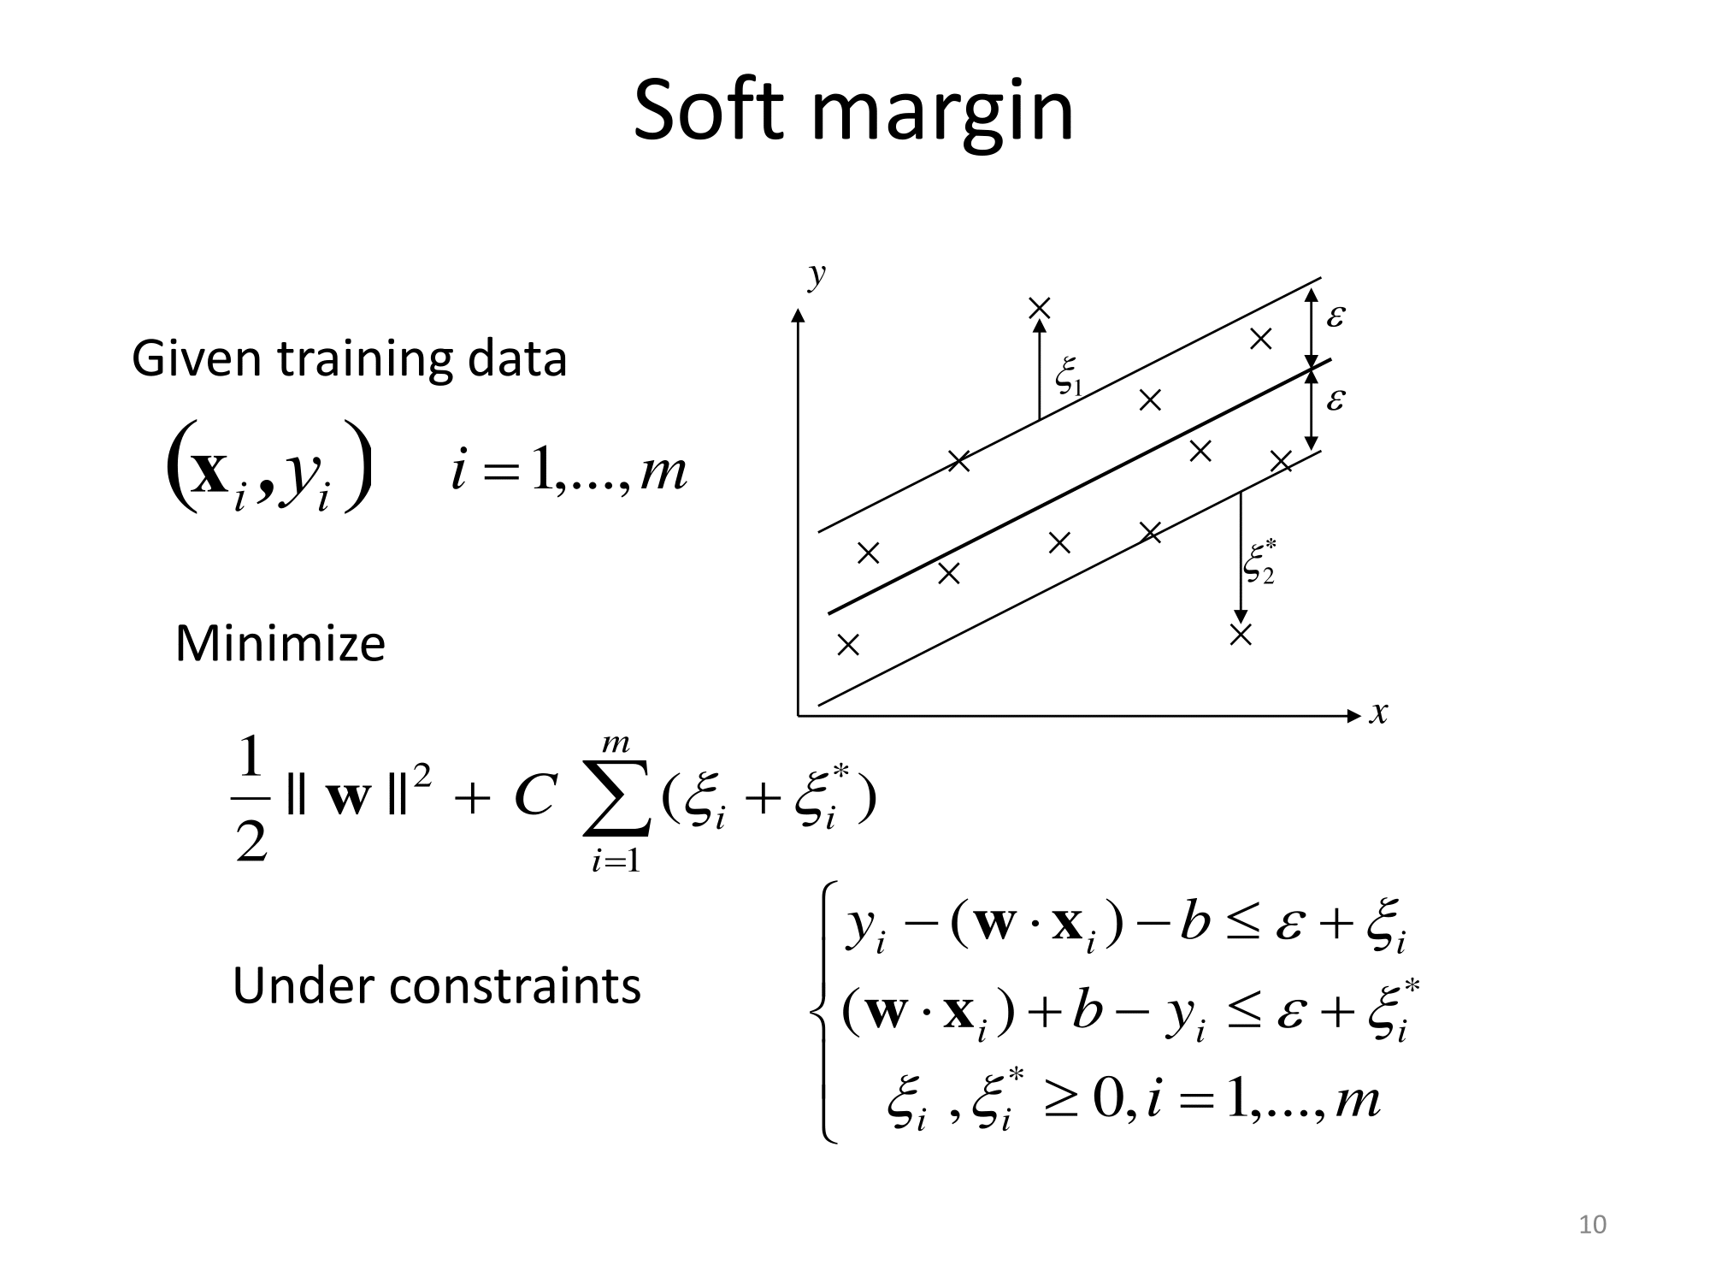

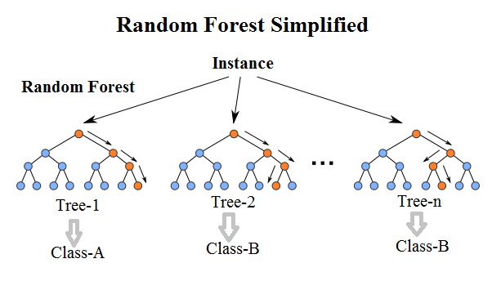
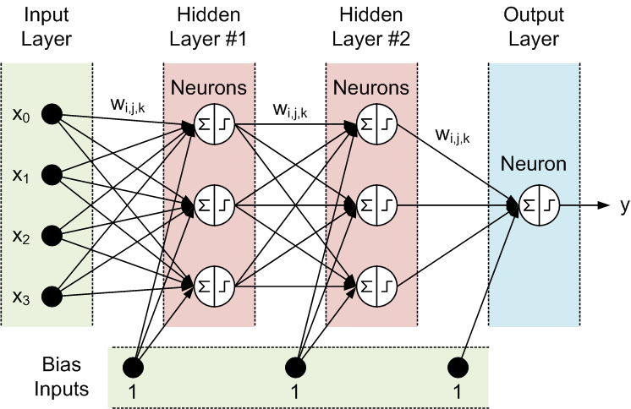

Potential Surrogate models (i.e., ROMs)
Support Vector Machines
Neural Networks
7

Slide 8
ROM Modeling Within RAVEN
All modeling steps that involve ROMs are available in RAVEN
Create ROMs from a database
Perform statistical analysis using ROMs

Slide 9
ROM Modeling Within RAVEN
Create a Database (PointSet)

Slide 10
ROM Modeling Within RAVEN
Create and train a ROM from a Database

Slide 11
ROM Modeling Within RAVEN
Perform statistical analysis using the ROM

Slide 12
ROM Pickle
Compression/serialization scheme
Pickled object contains all the information necessary to reconstruct the object in another python script
Pickled object can be saved as a file
RAVEN Scikit-Learn ROMs can be pickled
Applications:
Perform statistical analysis on a ROM after they have been generated and/or on a different machine
Use pickled ROMs on separate python script (external model for RAVEN)
Stochastic analysis for different distributions

Slide 13
ROMs Available in RAVEN
NDspline/NDinvDistWeight: Multi-dimensional interpolators
GaussPolynomialRom/HDMRRom: Stochastic collocation
SciKitLearn (External library)
Linear Models
Support Vector Machines
Multi Class
Naïve Bayes
Neighbors
Tree
Gaussian process
Neural Network Models
ARMA: Autoregressive moving average time series model
MSR: Perform topological decomposition
PolyExponential: polynomial sum of exponentials for time-dependent
DMD: dynamic mode decomposition for time-dependent ROM

Slide 14
RAVEN Examples

Slide 15
Getting on the same page
This workshop will include interactive examples
paths given starting at raven
Slides are provided as well:
~> cd ~/projects/raven
~/projects/raven> git checkout devel
~/projects/raven> git pull
raven/doc/workshop/reducedOrderModeling

Slide 16
Example Code
RAVEN samples codes
For experiment, we’ve provided some physics in a code
projectile.py
Given:
y0, the initial vertical position
x0, the initial horizontal position
angle, the launch angle
v0, the launch velocity
Calculates:
x, the horizontal position throughout the trajectory
y, the vertical position throughout the trajectory
r, the horizontal range or furthest point reached if landed on the same horizontal level.
t, the time of flight.
ymax, the maximum height achieved.

Slide 17
Workflow/Pipeline
2_train_rom.xml
4_load_rom.xml
Train a ROM
(Validate Visually)
Pickle ROM
Load ROM
Sample model Create database
Train and Validate
3_pickle_rom.xml
Train and Validate
1_sample_Function.xml
2b_train_and_validate_rom.xml
4b_load_pretrained_rom.xml
5_sample_rom.xml
Sample/evaluate ROM
Sample/evaluate pROM
6_sample_prom.xml

Slide 18
Exercises
Exercise 1_sample_Function.xml, objective: prepare the training data via forward sampling.
Just run this one
Exercise 2_train_rom.xml, objective: Construct/train a ROM.
Add a RomTrainer Step
Exercise 3_pickle_rom.xml, objective: Save a ROM for future use.
Use IOStep to picke a ROM
Exercise 4_load_rom.xml, objective: load a previously trained ROM
Use IOStep to load a ROM
Exercise 5_sample_rom.xml, objective: Sample/evaluate a ROM immediately after training.
Use MultiRun to sample a ROM
Exercise 6_sample_prom.xml, objective: Sample a previously pickled ROM :
Use MultiRun to sample a pickled ROM

Slide 19
Exercises 1, 2
Exercise 1_sample_Function.xml, objective: prepare the training data via forward sampling.
Just run this one.
Outputs:

Slide 20
Workflow
Sample model Create data
1_sample_Function.xml
Train a ROM
Pickle ROM
Train a ROM
Sample ROM
rom_trainer.xml
sample_ROM.xml
Load ROM
Sample ROM
sample_pROM.xml

Slide 21
Sample a Model and Create a Database (Exercise 1)
Distributions
Models
Samplers
Databases
DataObjects
Steps
<Steps>
<MultiRun name="FirstMRun">
<Input class="DataObjects" type="PointSet" >inputPlaceHolder</Input>
<Model class="Models" type="ExternalModel”>projectile</Model>
<Sampler class="Samplers" type="Grid" >grid</Sampler>
<Output class="DataObjects" type="PointSet" >outGRID</Output>
<Output class="Databases" type="HDF5" >out_db</Output>
<Output class="OutStreams" type="Print" >out_dump</Output>
</MultiRun>
</Steps>
Model file
Step
Database
Model info
Sampler
DataObjects
Starter input file name: 1_sample_Function.xml (Just run it!)

Slide 22
Workflow
Sample model Create data
sample_Function.xml
Train a ROM
Pickle ROM
Train a ROM
Sample ROM
rom_trainer.xml
sample_ROM.xml
Load ROM
Sample ROM
sample_pROM.xml

Slide 23
Train and Sample a ROM
Distributions
Models
Samplers
Databases
DataObjects
Steps
<Models>
<ROM name="ROM4" subType="NDinvDistWeight">
<Features>v0,angle</Features>
<Target>t,x,y,r</Target>
<p>3</p>
</ROM>
</Models>
Multi-dimensional interpolator (CROW)
Input file name: sample_ROM.xml

Slide 24
Train and Sample a ROM
Distributions
Models
Samplers
Databases
DataObjects
Steps
<Samplers>
<Grid name="Grid_ROM">
<variable name=”v0">
<distribution>v0_d</distribution>
<grid type=”CDF" construction="equal" steps="10">0.1 0.9</grid>
</variable>
<variable name=”angle">
<distribution>angle_d</distribution>
<grid type=”CDF" construction="equal" steps="10”>0.1 0.9</grid>
</variable>
</Grid>
</Samplers>
Finer grid
Input file name: sample_ROM.xml

Slide 25
Train and Sample a ROM
Distributions
Models
Samplers
Databases
DataObjects
Steps
<Steps>
<IOStep name="extract_data4">
<Input class="Databases" type="HDF5" >out_db</Input>
<Output class="DataObjects" type="PointSet" >outGRID_y4</Output>
</IOStep>
<RomTrainer name="rom_trainer4">
<Input class="DataObjects" type="PointSet" >outGRID_y4</Input>
<Output class="Models" type="ROM" >ROM4</Output>
</RomTrainer>
<MultiRun name="RunRom4">
<Input class="DataObjects" type="PointSet" >Data1</Input>
<Model class="Models" type="ROM" >ROM4</Model>
<Sampler class="Samplers" type="Grid" >grid</Sampler>
<Output class="DataObjects" type="PointSet" >outROM_y4</Output>
</MultiRun>
...
</Steps>
Input file name: sample_ROM.xml

Slide 26
Workflow
Sample model Create data
sample_Function.xml
Train a ROM
Pickle ROM
Train a ROM
Sample ROM
rom_trainer.xml
sample_ROM.xml
Load ROM
Sample ROM
sample_pROM.xml

Slide 27
Train and Pickle a ROM
Models
Databases
DataObjects
Steps
<Models>
<ROM name="ROM3" subType="SciKitLearn">
<Features>v0,angle</Features>
<Target>t,x,y,r</Target>
<SKLtype>linear_model|LinearRegression</SKLtype>
<fit_intercept>True</fit_intercept>
<normalize>False</normalize>
</ROM>
</Models>
Inputs / Output
ROM type and parameters
Input file name: rom_trainer.xml
Notes:
Add multi target ROM

Slide 28
Train and Pickle a ROM
Models
Databases
DataObjects
Steps
Create a DataObject from the Dababase
<Steps>
<IOStep name="extract_data3">
<Input class="Databases" type="HDF5" >out_db</Input>
<Output class="DataObjects" type="PointSet" >outGRID_y3</Output>
</IOStep>
<RomTrainer name="rom_trainer3">
<Input class="DataObjects" type="PointSet" >outGRID_y3</Input>
<Output class="Models" type="ROM" >ROM3</Output>
</RomTrainer>
<IOStep name="pkDump3">
<Input class="Models" type="ROM" >ROM3</Input>
<Output class="Files" type="" >ROM3pk</Output>
</IOStep>
</Steps>
Create and train a ROM from the DataObject
Pickle the ROM and save it as a file
Input file name: rom_trainer.xml

Slide 29
Workflow
Sample model Create data
sample_Function.xml
Train a ROM
Pickle ROM
Train a ROM
Sample ROM
rom_trainer.xml
sample_ROM.xml
Load ROM
Sample ROM
sample_pROM.xml

Slide 30
Load and Sample a Pickled ROM
Distributions
Models
Samplers
DataObjects
Steps
<Models>
<ROM name=”pROM3" subType="SciKitLearn">
<Features>v0,angle</Features>
<Target>t,x,y,r</Target>
<SKLtype>linear_model|LinearRegression</SKLtype>
<fit_intercept>True</fit_intercept>
<normalize>False</normalize>
</ROM>
</Models>
Inputs / Output
ROM type and parameters
Input file name: sample_pROM.xml

Slide 31
Load and Sample a Pickled ROM
Distributions
Models
Samplers
DataObjects
Steps
Load the pickled ROM
<Steps>
...
<IOStep name="pk3Load">
<Input class="Files" type="" >ROM3pk</Input>
<Output class="Models" type="ROM" >pROM3</Output>
</IOStep>
<MultiRun name="RunPROM3">
<Input class="DataObjects" type="PointSet" >Data1</Input>
<Model class="Models" type="ROM" >pROM3</Model>
<Sampler class="Samplers" type="Grid" >grid</Sampler>
<Output class="DataObjects" type="PointSet" >outPROM_y3</Output>
<Output class="Databases" type="HDF5" >out_ROM3_db</Output>
</MultiRun>
...
</Steps>
Input file name: sample_pROM.xml

Slide 32
Exercises
Exercise 7_evaluate_rom.xml, objective: Evaluate a ROM:
Add additional MonteCarlo Sampler to evaluate a ROM
Change the number of samples: 20, 100, 200, 1000
SciKitLearn Rom: Linear Regression
Generalized Polynomial Chaos

Slide 33
Backup Slides

Slide 34
Generalized Polynomial Chaos
Objective: overcome limitations of Monte-Carlo sampling
High number of samples
Computationally expensive
Polynomial representation of an output variable
Simpler to evaluate
Easy to get statistical moments
Less effort and more accurate than Monte Carlo
index set of all desired polynomial orders up to order L

